Slide 1
Digital Portfolio
STUDENT NAME: Hari Varma B
REGISTER NO AND NMID: 5CBDE7EC5D150C9BFE54C4294791B775
DEPARTMENT: ISM
COLLEGE: Shanmuga industries arts and science COLLEGE/Thiruvalluvar UNIVERSITY

Slide 2
PROJECT TITLE
Personal Portfolio

Slide 3


AGENDA
Problem Statement
Project Overview
End Users
Tools and Technologies
Portfolio design and Layout
Features and Functionality
Results and Screenshots
Conclusion
Github Link
3/21/2024 Annual Review

Slide 4

PROBLEM STATEMENT
In today's digital world, showcasing skills and projects online is essential for developers and professionals. However, many beginners or students lack a structured, professional platform to present their capabilities, especially when applying for internships or freelance work. This project solves the problem by providing a clean, responsive, and informative personal portfolio website for a web developer to:

Slide 5

PROJECT OVERVIEW
This project is a Personal Portfolio Website for "Hari Varma", a web developer and student. The site is designed as a single-page application (SPA) using HTML, CSS, and JavaScript. It features sections such as: Home (Introduction) About (Background and interests) Projects (Showcasing past work) Contact (Simple contact form)

Slide 6

WHO ARE THE END USERS?
The primary end users of this portfolio website are: Potential Employers or Clients Hari Varm's skills and previous work. Looking to evaluate Peers or Educators For academic evaluations or peer feedback. Freelance Platforms or Recruiters To verify Hari Varma s capabilities and reach out for projects.

Slide 7

TOOLS AND TECHNIQUES
This portfolio is built using basic but essential web technologies: HTML5 markup. For content structure and semantic CSS3 For design, layout, and responsiveness (including media queries). JavaScript For form validation and basic interactivity.

Slide 8
POTFOLIO DESIGN AND LAYOUT
Header/Nav Bar (fixed top) Hero Section (Home) Name and brief intro. About Section Educational background and goals. Projects Section Highlights of 3 sample projects. Contact Section Simple form for users to get in touch. Footer Copyright.
8

Slide 9
FEATURES AND FUNCTIONALITY
Smooth scrolling navigation for a better user experience. Responsive design across desktops, tablets, and phones. JavaScript form validation for basic error handling. Interactive hover effects on navigation links and buttons. Project showcase section with structured cards for each project. Mobile-friendly navbar via CSS media queries.

Slide 10
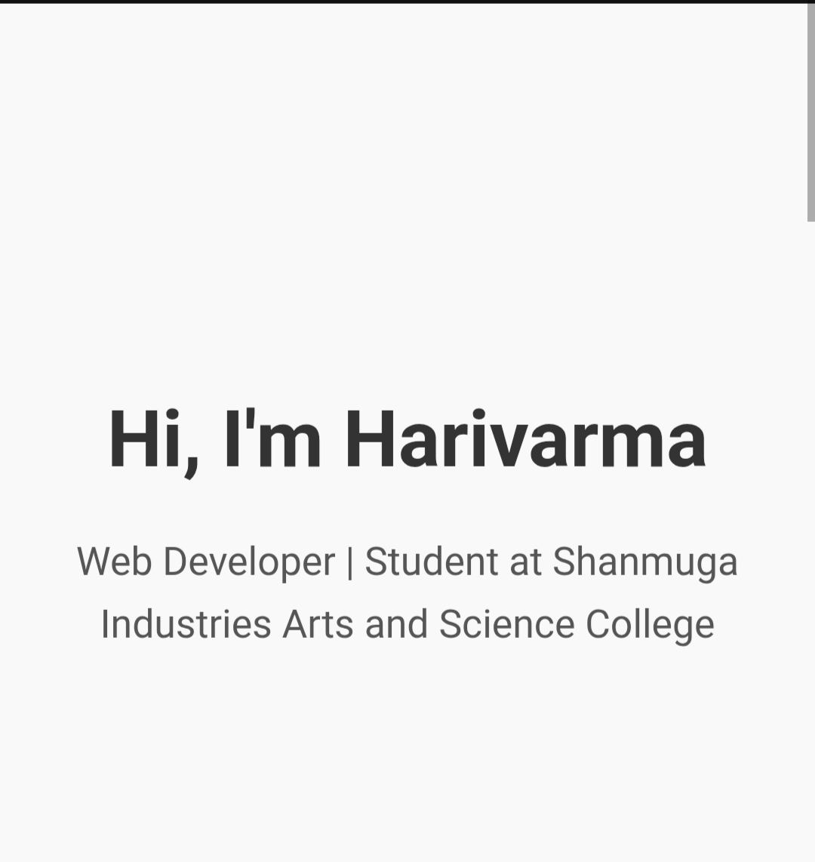

RESULTS AND SCREENSHOTS
3/21/2024 Annual Review
10

Slide 11
CONCLUSION
This Web Developer Portfolio Website is a solid foundation for anyone starting out in the tech industry. It effectively demonstrates Akash's front-end skills while offering a clean platform to showcase his projects and background. Simple and elegant design. Fully functional and responsive.
11

